Slide 1
Secure Data Hiding In Images Using Steganography
CAPSTONE PROJECT
CAPSTONE PROJECT
Presented By:
Student Name : Chaitali Jadhav
College Name : Institute Of Management Studies and Information Technology
Department : Master’s in Computer Application (MCA)

Slide 2
OUTLINE
Problem Statement
Technology used
Wow factor
End users
Result
Conclusion
Git-hub Link
Future scope

Slide 3
Problem Statement
Traditional encryption methods are easily detectable and can raise suspicion.
Need for a secure way to hide confidential messages within images.
Ensuring data security while maintaining the integrity of the cover image.
Making encryption and decryption accessible to non-technical users through a simple interface.

Slide 4
Technology used
Programming Language: Python
Image Processing Library: OpenCV
Graphical User Interface (GUI): Tkinter
File Handling & Security: Basic encryption logic for password protection
Additional Libraries: Pillow (for image handling)
Platform: Windows 10

Slide 5
Wow factors
Uses steganography to embed a message into an image without noticeable changes.
User-friendly GUI for easy encryption and decryption.
Lossless data hiding using pixel value manipulation instead of traditional cryptographic techniques.
Works on any standard image file format (PNG recommended for best results).

Slide 6
End users
Cybersecurity Enthusiasts – Exploring secure communication techniques.
Government & Defense – Secure message transmission without raising suspicion.
Journalists & Activists – Concealing sensitive information in images to avoid surveillance.
Software Developers – Learning steganography concepts and their applications.

Slide 7
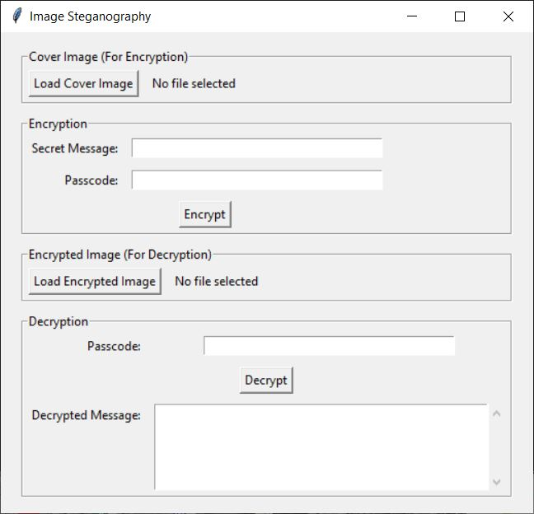
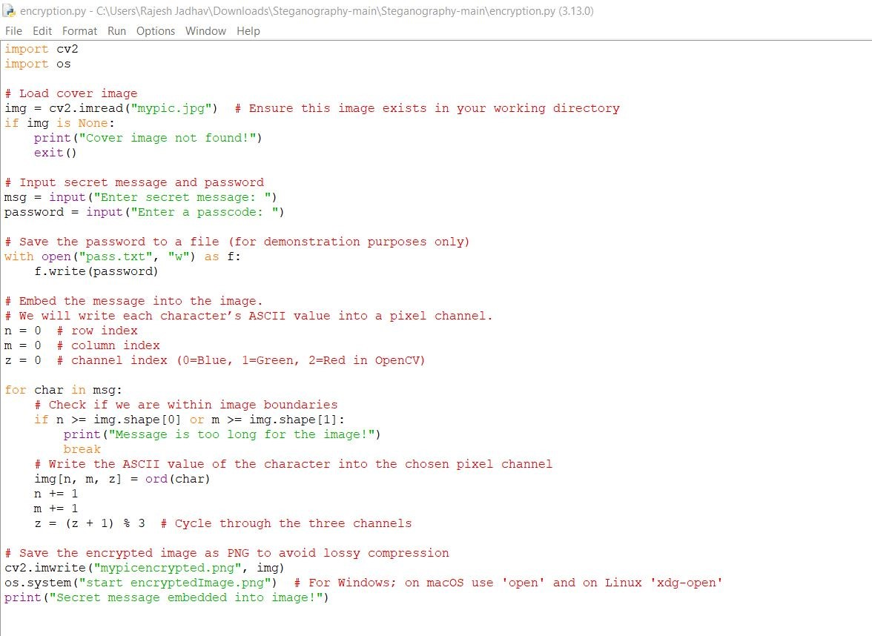


Results
Decryption Code:
GUI:
Encryption Code:
Input Image File:
Output Image File:

Slide 8
Conclusion
Steganography provides a covert way of communicating sensitive information.
This project showcases a simple yet effective implementation of message hiding in images.
The GUI makes encryption and decryption accessible even to non-technical users.
Future improvements can make it more robust, secure, and scalable.

Slide 9
GitHub Link
https://github.com/chaitalijadhav1123/AICTE-StegnographyProject.git

Slide 10
Future scope(optional)
Advanced Encryption Techniques – Integrate AES encryption before embedding text in images.
Support for Audio & Video Steganography – Expanding beyond images.
AI-based Detection Prevention – Ensuring messages stay undetectable from modern forensic tools.
Mobile App & Web Version – Expanding accessibility beyond desktops.
Multi-Layer Security – Combining steganography with blockchain for ultra-secure communication.

Slide 11
THANK YOU

